Slide 1
CS 4530 & CS 5500
Software Engineering
Lecture 9.4: Engineering Secure Software
Jonathan Bell, John Boyland, Mitch Wand
Khoury College of Computer Sciences © 2021, released under CC BY-SA

Slide 2
Learning Objectives for this Lesson
By the end of this lesson, you should be able to…
Recognize the causes of and common mitigations for common vulnerabilities in web applications
Utilize static analysis tools to identify common weaknesses in code

Slide 3
OWASP Top Security Risks
All 10: https://owasp.org/www-project-top-ten/
Code injection (various forms - SQL/command line/XSS/XML/deserialization)
Broken authentication + access control
Weakly protected sensitive data
Using components with known vulnerabilities

Slide 4
Code Injection Example
OWASP A1:2017-Injection
String query = "SELECT * FROM accounts WHERE name='" + request.getParameter(“name") + "'";
Parameter name | Constructed Query | Effect
Alice | SELECT * FROM accounts WHERE name=‘Alice’; | Select a single account
Alice O’Neal | SELECT * FROM accounts WHERE name=‘Alice O’Neal’; | SQL Error
5’ OR ‘1’=‘1 | SELECT * FROM accounts WHERE name=‘5’ OR ‘1’=‘1’; | Select all accounts
This is an attack
Notes:
This one is going to be much harder

Slide 5
Code Injection Example
XKCD #327
Notes:
Pop culture reference

Slide 6

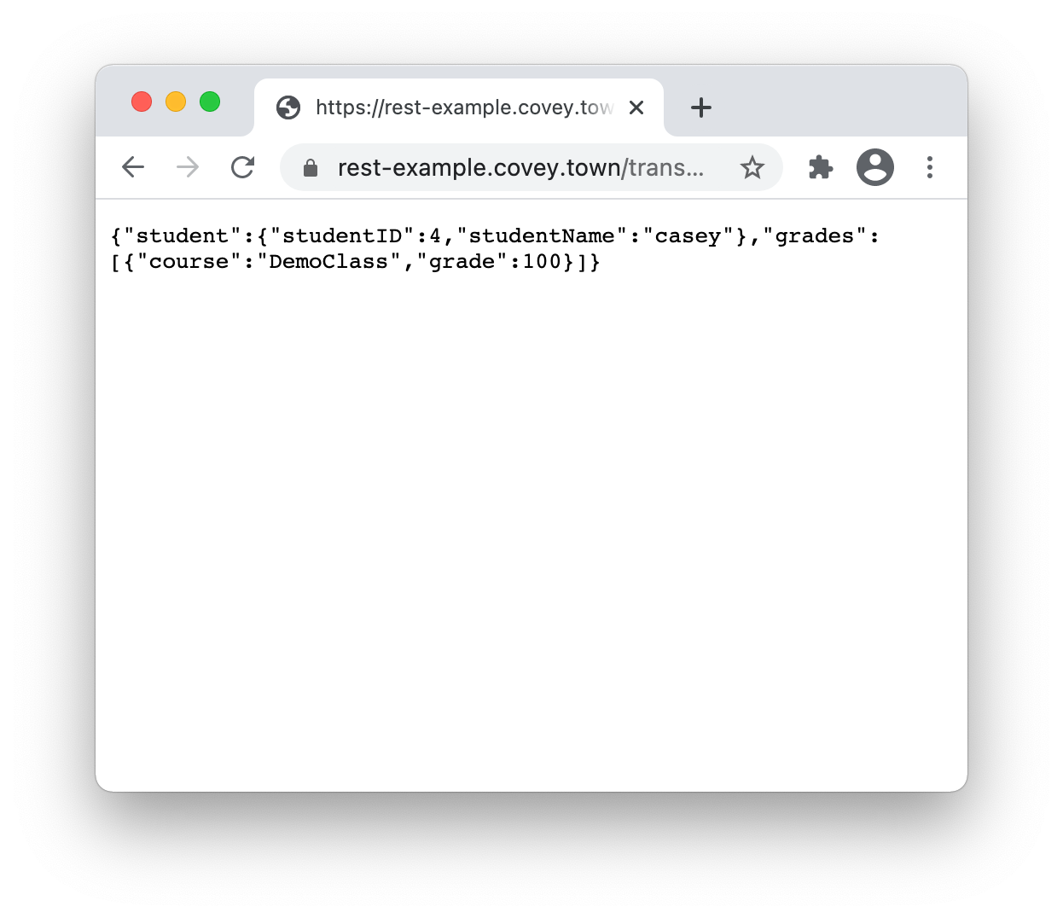
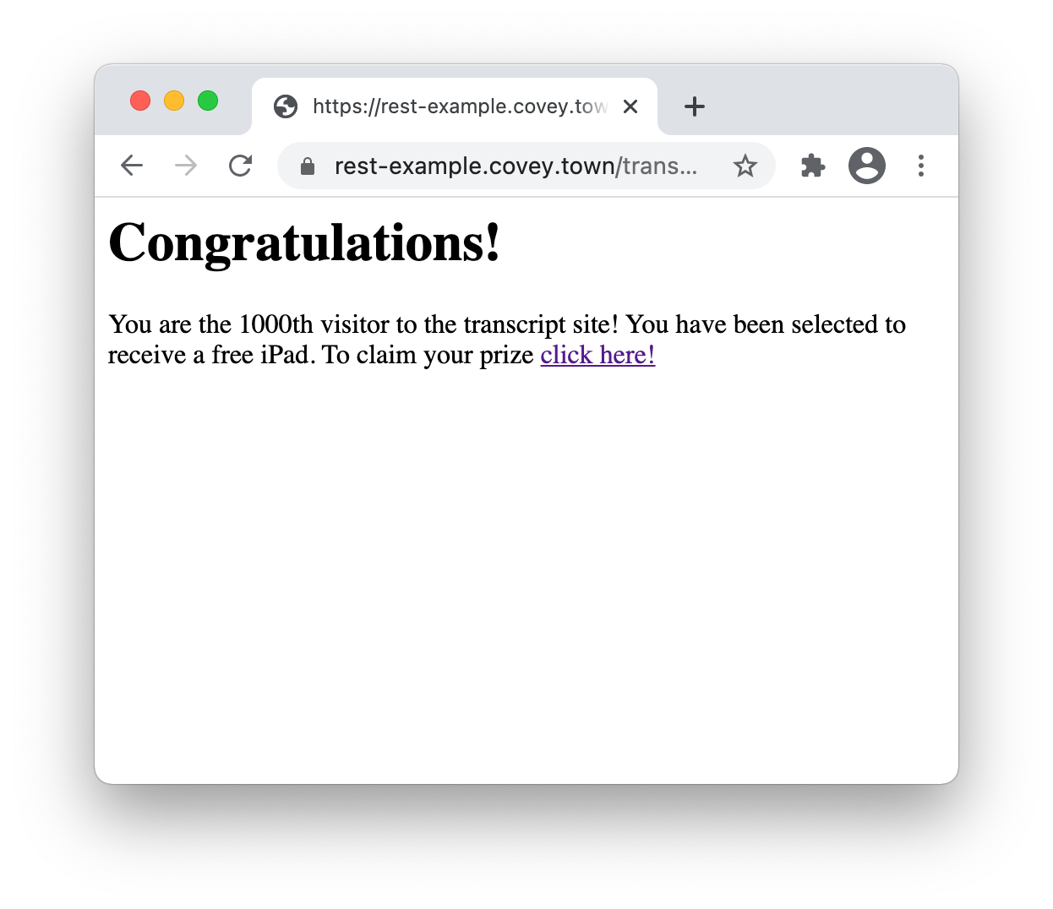
Code Injection Example
Cross-site scripting (XSS)
Trusted Server
Malicious JavaScript Response

Slide 7
Code Injection Example
Cross-site scripting (XSS)
app.get('/transcripts/:id', (req, res) => {
// req.params to get components of the path
const {id} = req.params;
const theTranscript = db.getTranscript(parseInt(id));
if (theTranscript === undefined) {
res.status(404).send(`No student with id = ${id}`);
}
{
res.status(200).send(theTranscript);
}
});
Trusted Server
/transcripts/4

Slide 8
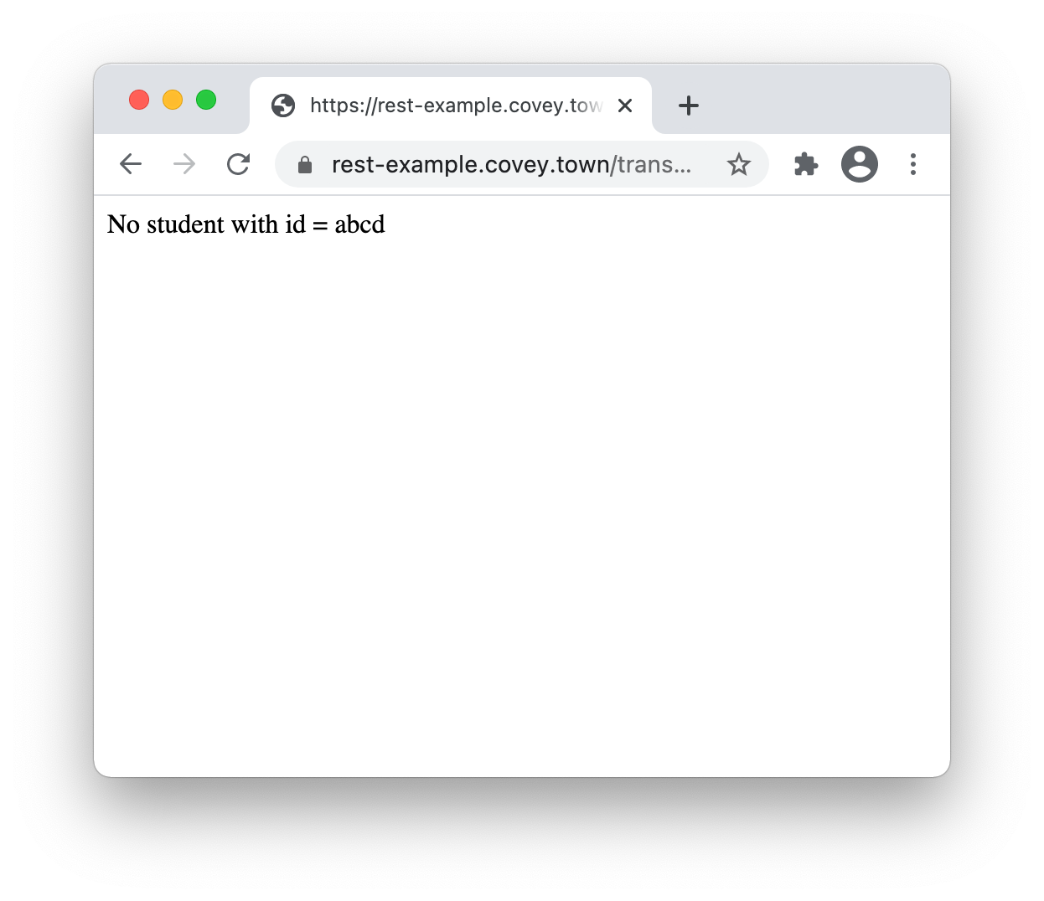
Code Injection Example
Cross-site scripting (XSS)
app.get('/transcripts/:id', (req, res) => {
// req.params to get components of the path
const {id} = req.params;
const theTranscript = db.getTranscript(parseInt(id));
if (theTranscript === undefined) {
res.status(404).send(`No student with id = ${id}`);
}
{
res.status(200).send(theTranscript);
}
});
Trusted Server
/transcripts/abcd

Slide 9
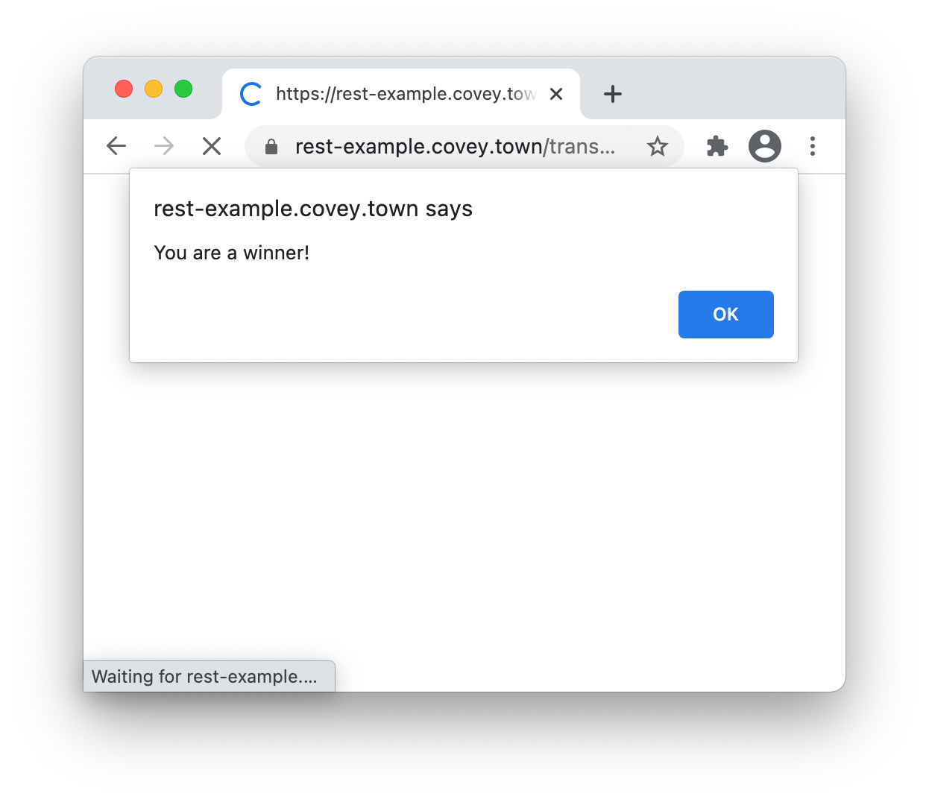
Code Injection Example
Cross-site scripting (XSS)
app.get('/transcripts/:id', (req, res) => {
// req.params to get components of the path
const {id} = req.params;
const theTranscript = db.getTranscript(parseInt(id));
if (theTranscript === undefined) {
res.status(404).send(`No student with id = ${id}`);
}
{
res.status(200).send(theTranscript);
}
});
Trusted Server
/transcripts/%3Ch1%3e…
<h1>Congratulations!</h1>
You are the 1000th visitor to the transcript site! You have been selected to receive a free iPad. To claim your prize <a href='https://www.youtube.com/watch?v=DLzxrzFCyOs'>click here!</a>
<script language=“javascript”>
document.getRootNode().body.innerHTML=
'<h1>Congratulations!</h1>You are the 1000th visitor to the transcript site! You have been selected to receive a free iPad. To claim your prize <a href="https://www.youtube.com/watch?v=DLzxrzFCyOs">click here!</a>’;
alert('You are a winner!’);
</script>

Slide 10
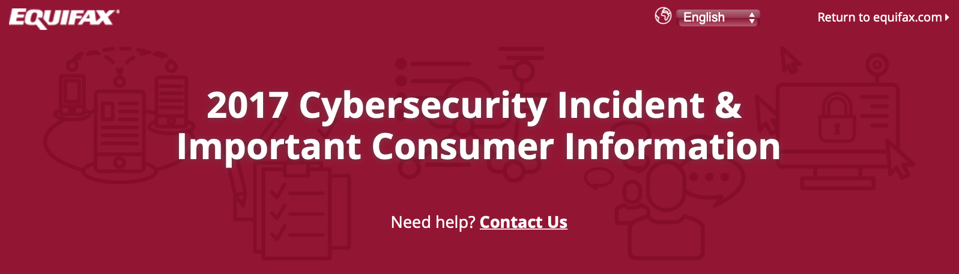
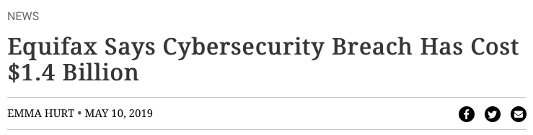
Code Injection Example
Java code injection in Apache Struts (@Equifax)
CVE-2017-5638 Detail
Current Description
The Jakarta Multipart parser in Apache Struts 2 2.3.x before 2.3.32 and 2.5.x before 2.5.10.1 has incorrect exception handling and error-message generation during file-upload attempts, which allows remote attackers to execute arbitrary commands via a crafted Content-Type, Content-Disposition, or Content-Length HTTP header, as exploited in the wild in March 2017 with a Content-Type header containing a #cmd= string.

Slide 11
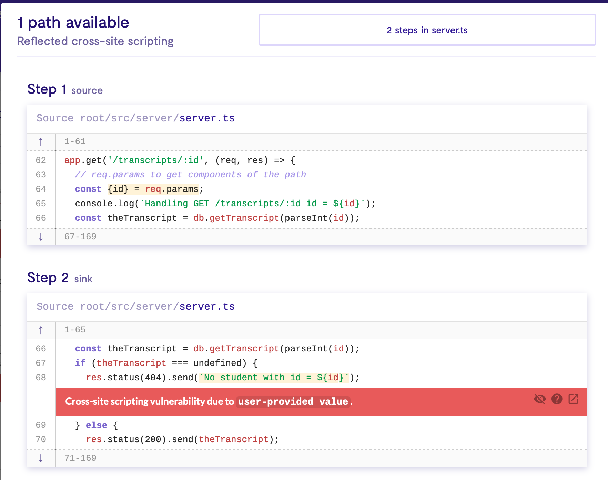
Cross-site Scripting
How to fix it?
Sanitize user-controlled inputs (remove HTML)
Use tools like LGTM to detect vulnerable data flows
Use middleware that side-steps the problem (e.g. return data as JSON, client puts that data into React component)

Slide 12
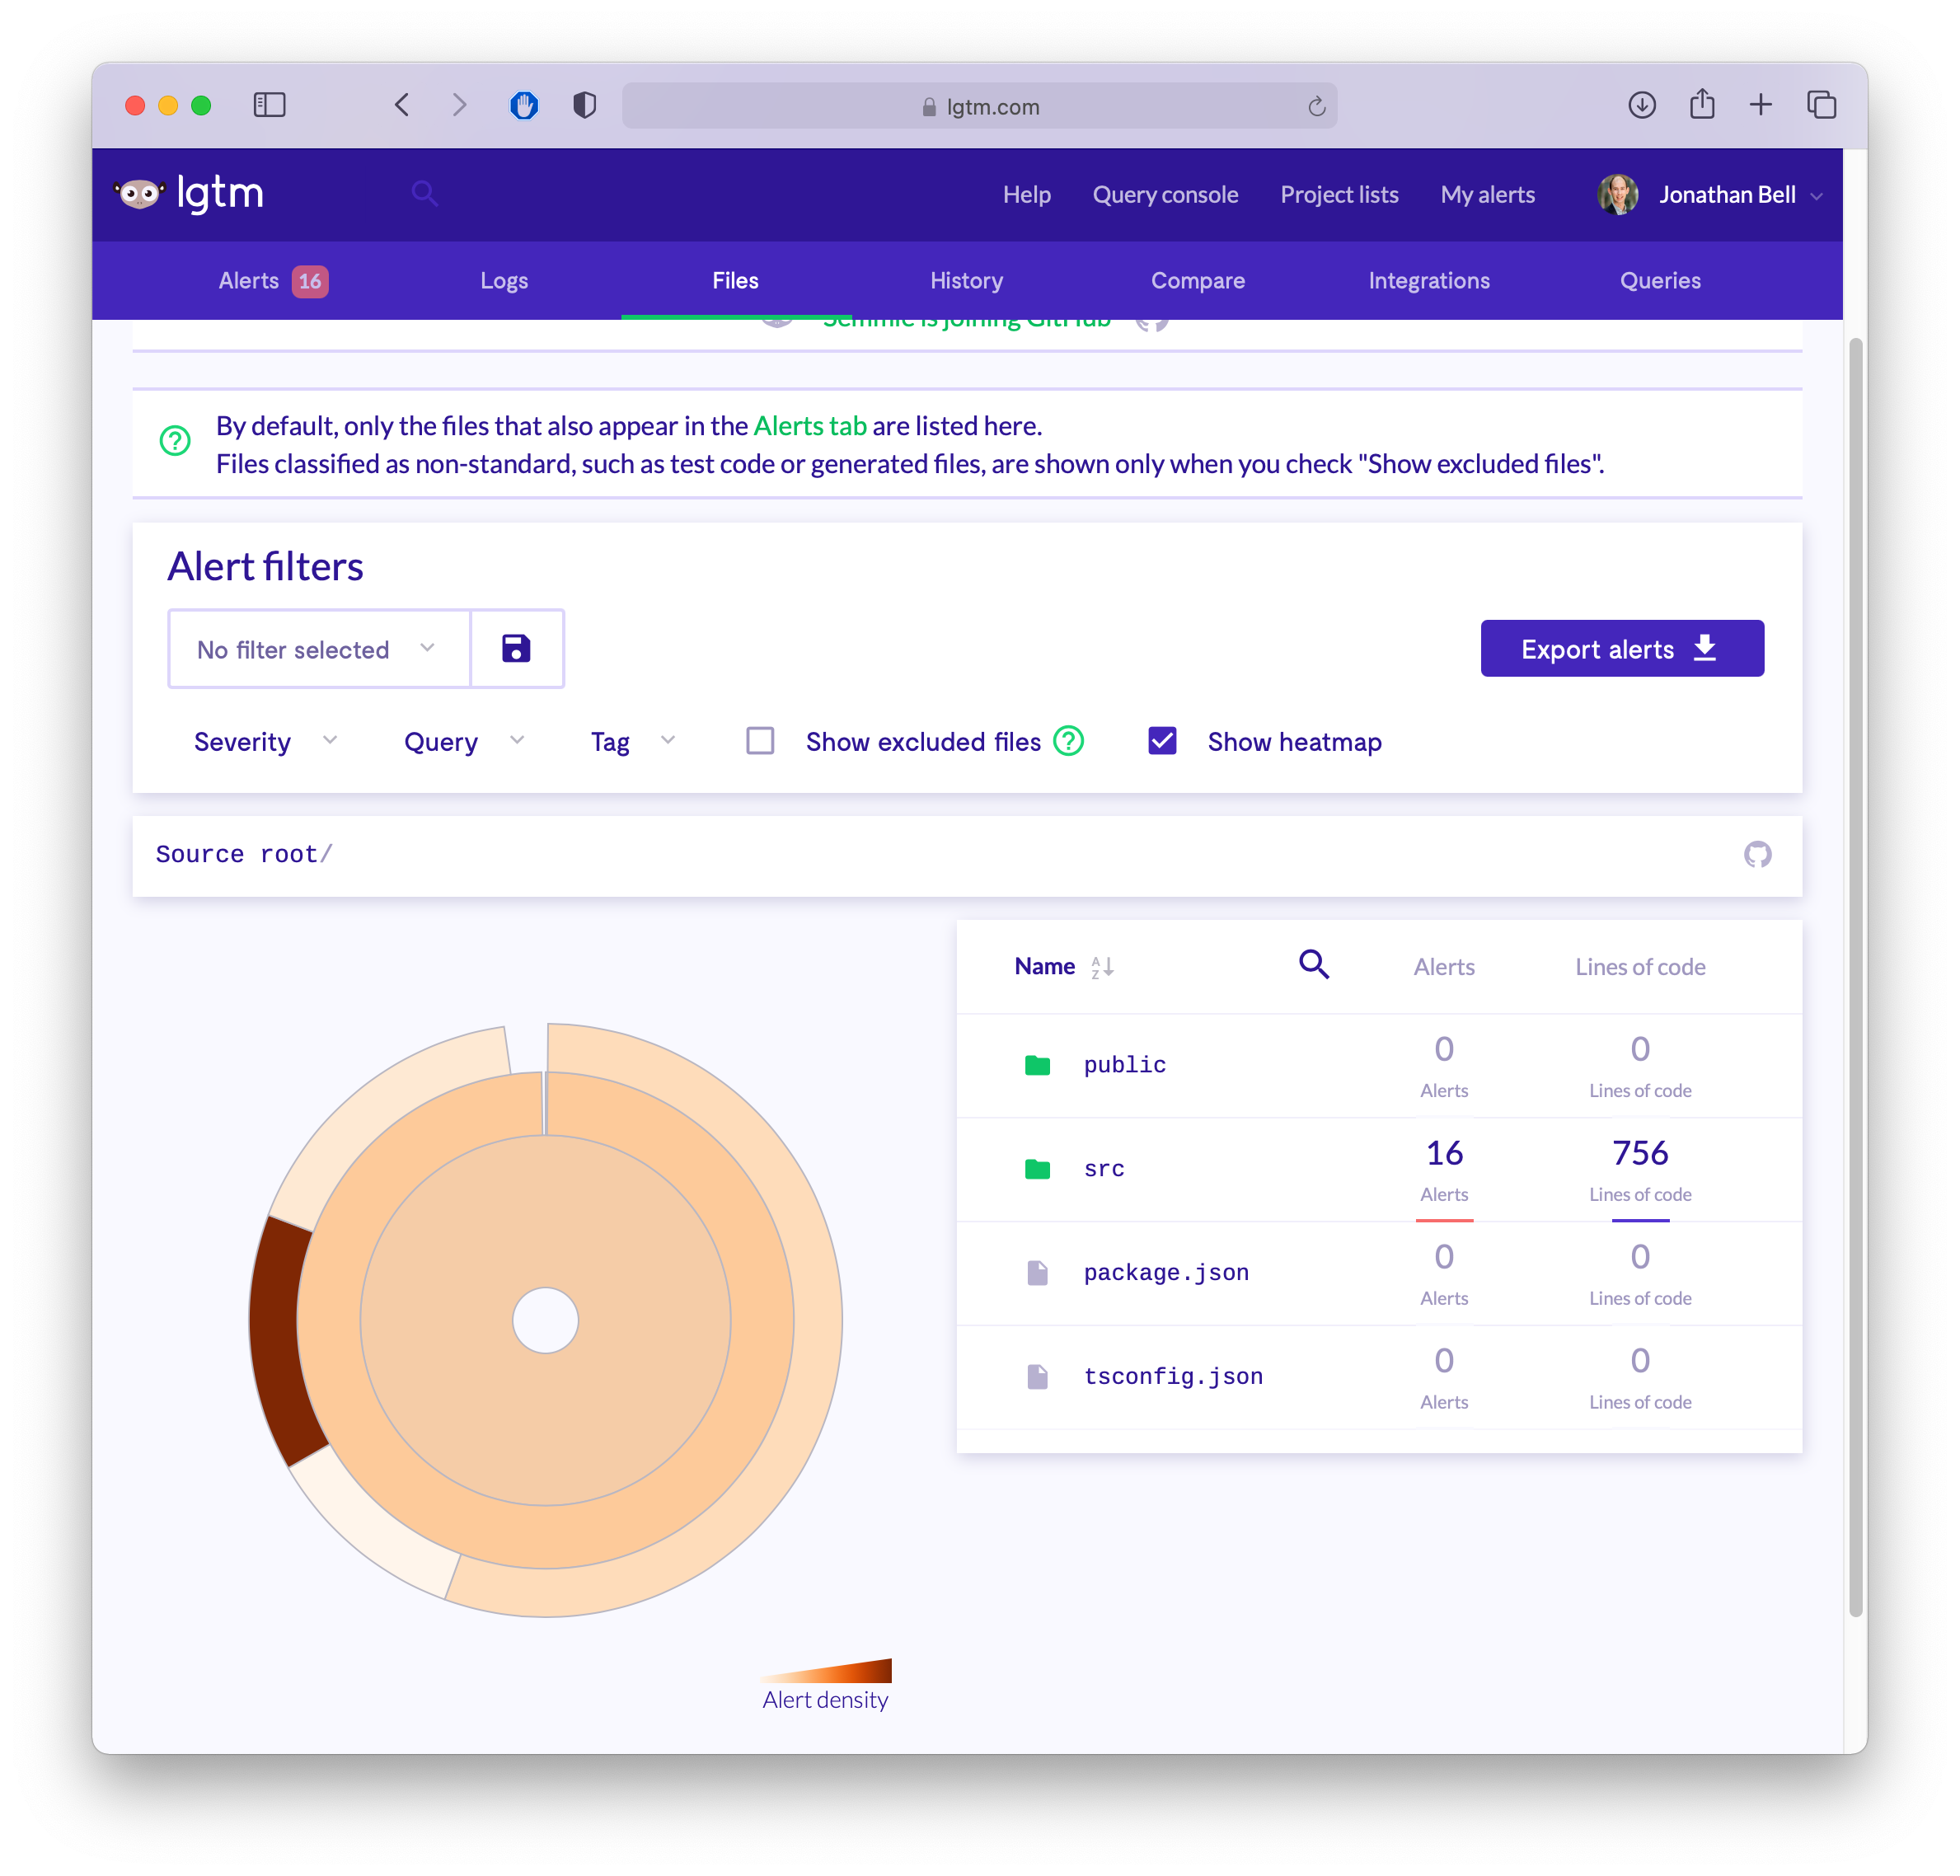
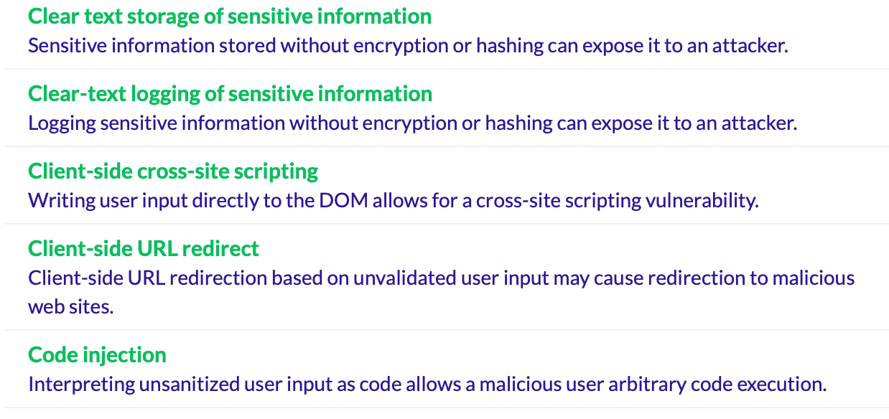
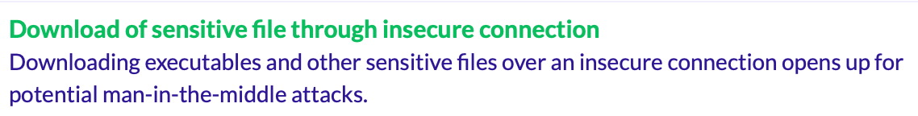
Detecting Weaknesses in Apps with Static Analysis
LGTM + CodeQL
https://lgtm.com

Slide 13
OWASP Top Security Risks
All 10: https://owasp.org/www-project-top-ten/
Code injection (various forms - SQL/command line/XSS/XML/deserialization)
Broken authentication + access control
Weakly protected sensitive data
Using components with known vulnerabilities

Slide 14
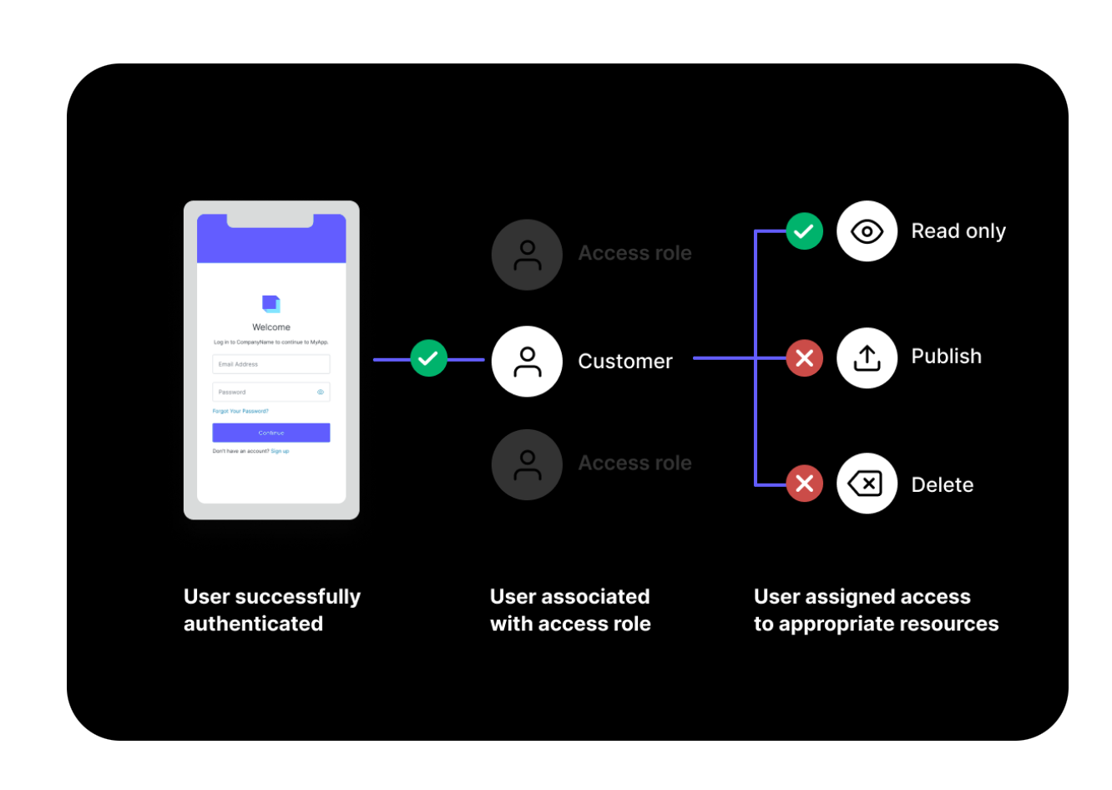
Broken Authentication + Access Control
How to fix it?
Implement multi-factor authentication
Implement weak-password checks
Apply per-record access control
Harden account creation, password reset pathways
The software engineering approach: rely on a trusted component
Auth0
https://auth0.com

Slide 15
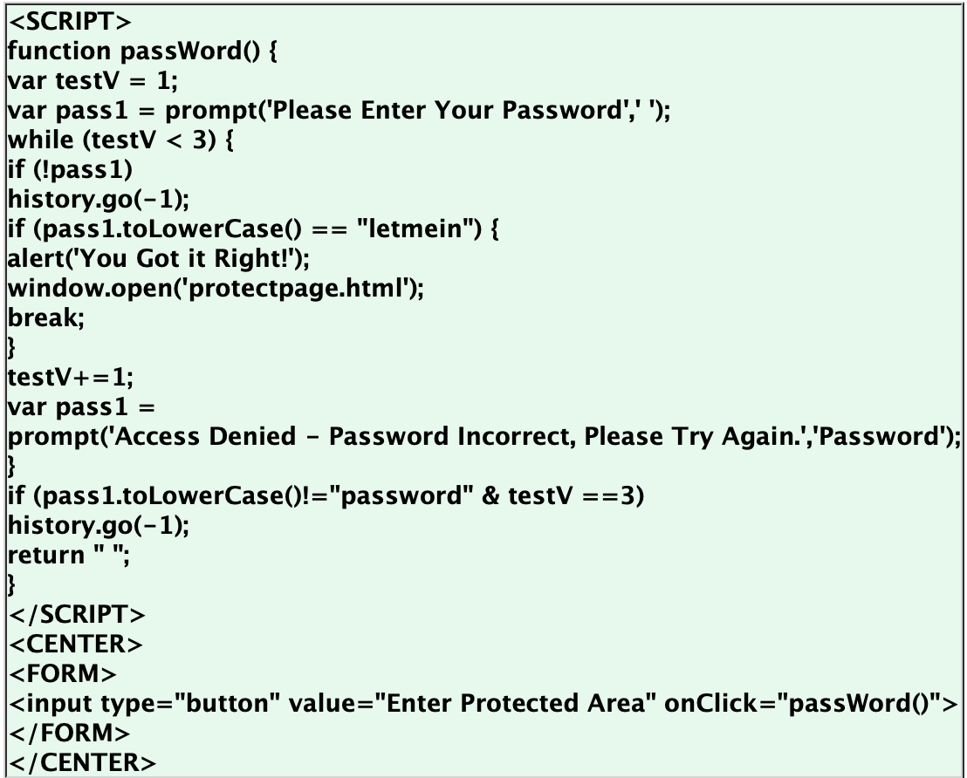
Broken Authentication + Access Control
Specifically: CWE-798: Use of Hard-coded Credentials

Slide 16
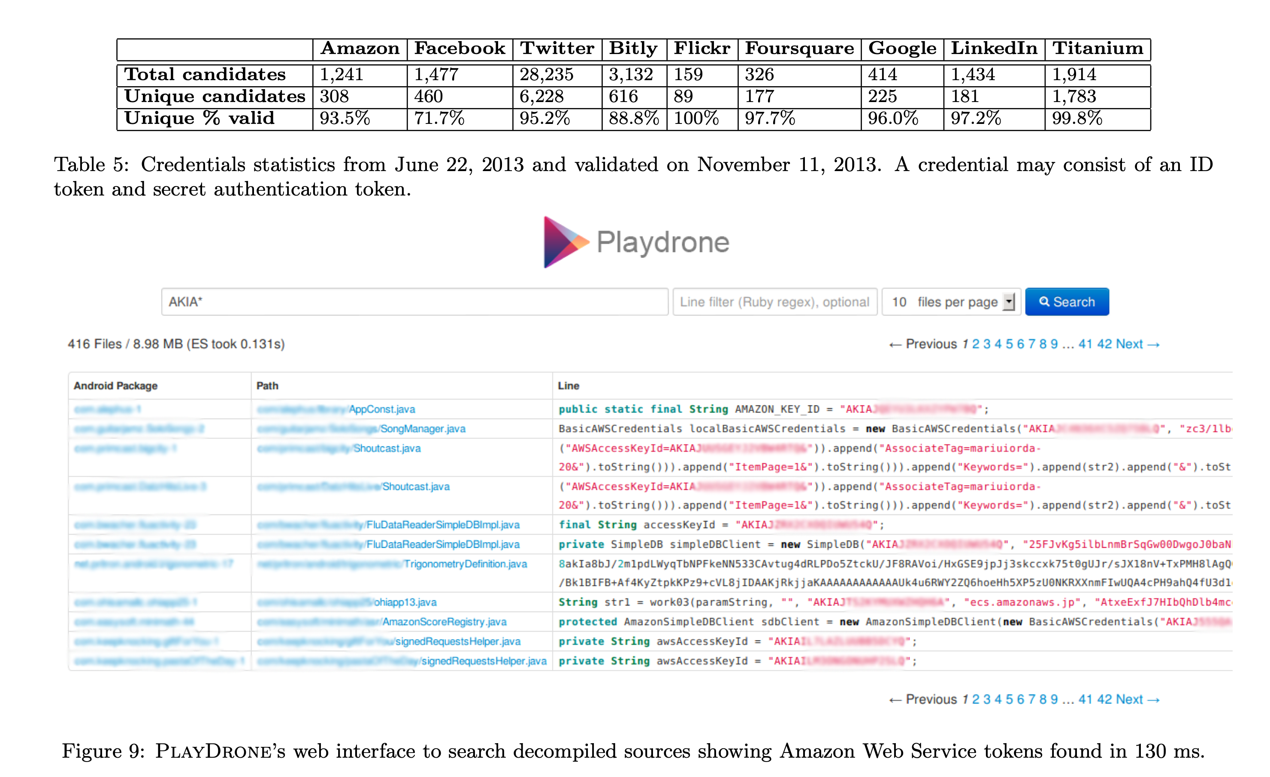
Broken Authentication + Access Control
CWE-798: Use of Hard-coded Credentials: Study of 1.1m Android Apps
“A Measurement Study of Google Play,” Viennot et al, SIGMETRICS ‘14

Slide 17
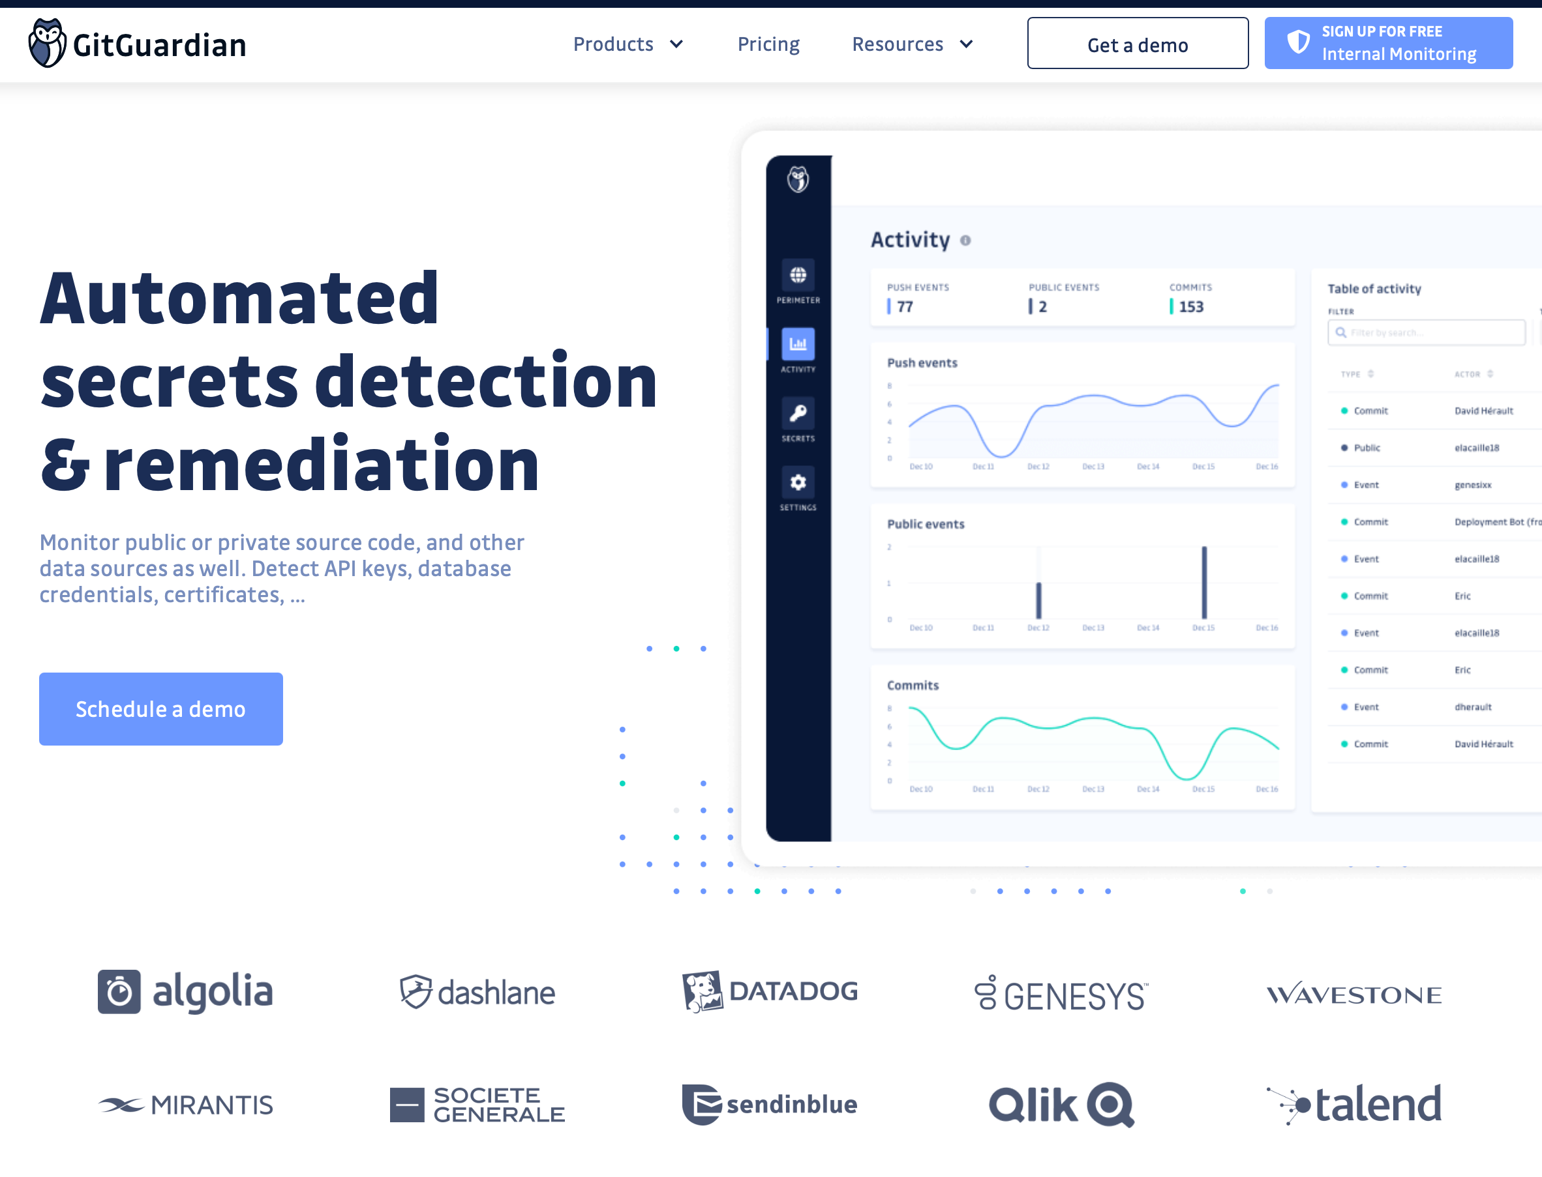
Hardcoded Credentials: Automated Checker
GitGuardian (Launched in 2017)
Notes:
How does it work? Just looks for regex, this is not actually that hard

Slide 18
OWASP Top Security Risks
All 10: https://owasp.org/www-project-top-ten/
Code injection (various forms - SQL/command line/XSS/XML/deserialization)
Broken authentication + access control
Weakly protected sensitive data
Using components with known vulnerabilities

Slide 19
Weakly Protected Sensitive Data
How to fix it?
Classify your data by sensitivity
Encrypt sensitive data - in transit and at rest
Make a plan for data controls, stick to it
Software engineering fix: can we avoid storing sensitive data?
Payment processors: Stripe, Square, etc

Slide 20
OWASP Top Security Risks
All 10: https://owasp.org/www-project-top-ten/
Code injection (various forms - SQL/command line/XSS/XML/deserialization)
Broken authentication + access control
Weakly protected sensitive data
Using components with known vulnerabilities

Slide 21
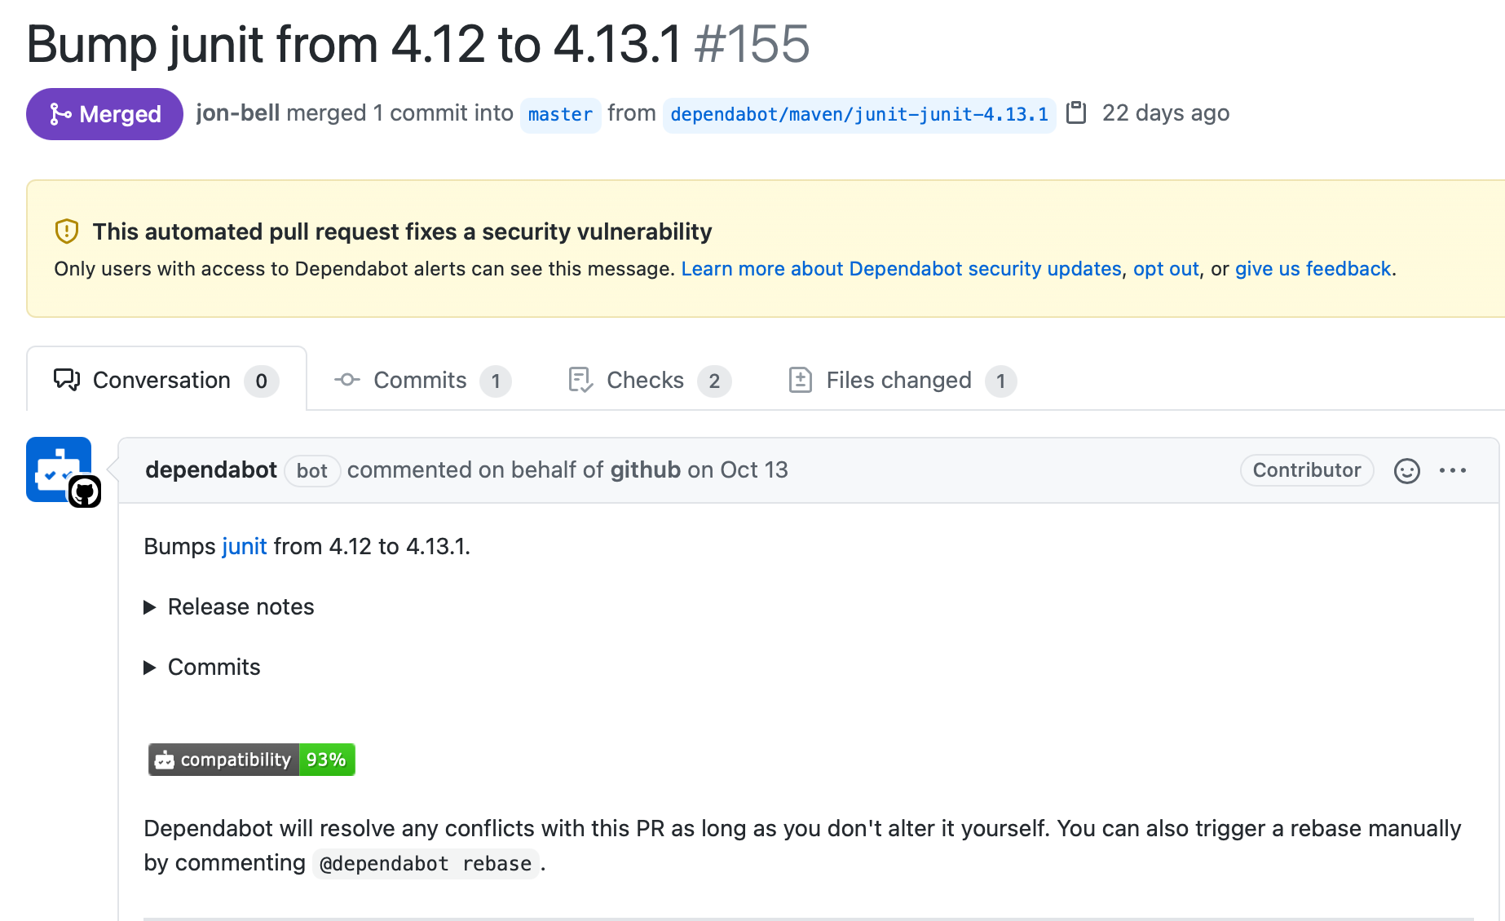
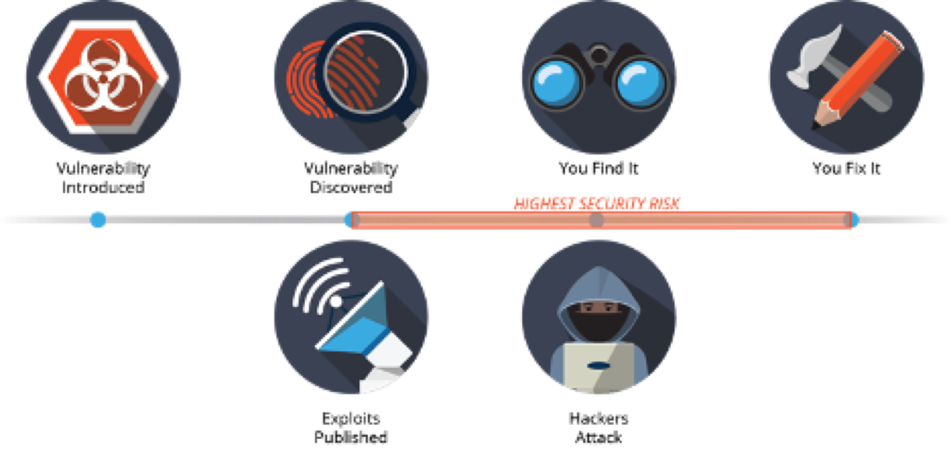
Using Components with Known Vulnerabilties
How to fix it?
Notes:
This one is also not that hard: just need to look at dependencies

Slide 22
Learning Objectives for this Lesson
By the end of this lesson, you should be able to…
Recognize the causes of and common mitigations for common vulnerabilities in web applications
Utilize static analysis tools to identify common weaknesses in code

Slide 23
This work is licensed under a Creative Commons Attribution-ShareAlike license
This work is licensed under the Creative Commons Attribution-ShareAlike 4.0 International License. To view a copy of this license, visit http://creativecommons.org/licenses/by-sa/4.0/
You are free to:
Share — copy and redistribute the material in any medium or format
Adapt — remix, transform, and build upon the material
for any purpose, even commercially.
Under the following terms:
Attribution — You must give appropriate credit, provide a link to the license, and indicate if changes were made. You may do so in any reasonable manner, but not in any way that suggests the licensor endorses you or your use.
ShareAlike — If you remix, transform, or build upon the material, you must distribute your contributions under the same license as the original.
No additional restrictions — You may not apply legal terms or technological measures that legally restrict others from doing anything the license permits.

